Slide 1
Numeracy and data cleaning
Lecture 01
EAS 42000 / EAS A4200
September 8, 2025

Slide 2
Today:
Numeracy in general
The Central Park weather station dataset

Slide 3
What do the following questions have in common?
To what extent are extreme rainfall events in New York City becoming more frequent, how much of that is caused by climate change?
What is the relationship between air pollution and child asthma? Is it the same in Harlem as in the Upper East Side?

Slide 4
What do the following questions have in common?
Answer: they can only meaningfully answered using statistics!
Why? The answers are not black and white. In fact there is no single objectively “true” answer.

Slide 5
What are statistical methods, and why do we need them in Earth & Atmospheric Sciences?
BUT with careful analysis using statistical techniques, we can provide reasonable answers to them and many more
And decisions by individuals and society can ultimately be informed (and improved) by using those answers
Whether to pack an umbrella, how to design subway entrances, etc.

Slide 6
Numeracy
Perhaps even more than building up a “toolbox” of techniques, we want to develop a state of mind for quantitative data analysis
A central part of this is numeracy: the ability to assess not just the sign (increasing/decreasing, more/less) but the magnitudes of different quantities that come up

Slide 7
Numeracy
Literacy: the ability to comprehend claims consisting of words
Numeracy: the ability to comprehend claims involving numbers

Slide 8
Numeracy example: a severe, damaging storm and climate change
Non-numerate claims (why?):
This storm was caused by climate change.
This storm was not caused by climate change.

Slide 9
Numeracy example: a severe, damaging storm and climate change
Non-numerate claims:
This storm was caused by climate change.
This storm was not caused by climate change.
Partially numerate claim (why?): The storm was 20% stronger because of climate change.

Slide 10
Numeracy example: a severe, damaging storm and climate change
More numerate claim (why?):
“The best estimate is an increase in the peak hourly rainfall accumulation of 20% due to climate change, with a 95% confidence interval of -5 to +35%.”

Slide 11
Numeracy example: a severe, damaging storm and climate change
More numerate claim (why?):
“The best estimate is an increase in the peak hourly rainfall accumulation of 20% due to climate change, with a 95% confidence interval of -5 to +35%.”
Better because it accounts for uncertainty

Slide 12
Numeracy example: a severe, damaging storm and climate change
“The best estimate is an increase in the peak hourly rainfall accumulation of 20% due to climate change, with a 95% confidence interval of -5 to +35%.”
Consider two other cases…very different what you can do with each!:
- increase of 20%, with 95% CI of -50 to +100%.”
- increase of 20%, with 95% CI of +18 to +22%.”

Slide 13
Numeracy example: a severe, damaging storm and climate change
Even better (why?):
“The best estimate is an increase in the peak hourly rainfall accumulation of 20% due to climate change, with a 95% confidence interval of -5 to +35% based on computer simulations of this event run either with the effect on greenhouse gases and other fields by human activities included or not.”

Slide 14
Numeracy example: a severe, damaging storm and climate change
Even better (quantitative, uncertainty, and methodology):
“The best estimate is an increase in the peak hourly rainfall accumulation of 20% due to climate change, with a 95% confidence interval of -5 to +35% based on computer simulations of this event run either with the effect on greenhouse gases and other fields by human activities included or not.”

Slide 15
“There are three kinds of lies: lies, damned lies, and statistics.” --Mark Twain
The applies most obviously to deliberate misinformation: presenting data in a misleading way in order promote a particular agenda or narrative.
This is misconduct, plain and simple. You should never do this.
Or, even worse, fraud: altering or making up data to get the result you want

Slide 16
“There are three kinds of lies: lies, damned lies, and statistics.” --Mark Twain
But there are subtler forms of deceit, often to your own self, such as:
Having a pre-determined narrative/theory/explanation, and only looking for that in your data
“p hacking” etc.: monkeying around with your methods to meet some specified measure of “statistical significance”

Slide 17
Another quote
“Knowledge is knowing that a tomato is a fruit. Wisdom is knowing not to put it in a fruit salad.” -Brian O’Driscoll
(Food for thought: what’s the tomato, what’s the fruit salad when it comes to quantitative data analysis?)
https://www.brainyquote.com/quotes/brian_odriscoll_680037

Slide 18
Today:
Numeracy in general ✅
The Central Park weather station dataset

Slide 19
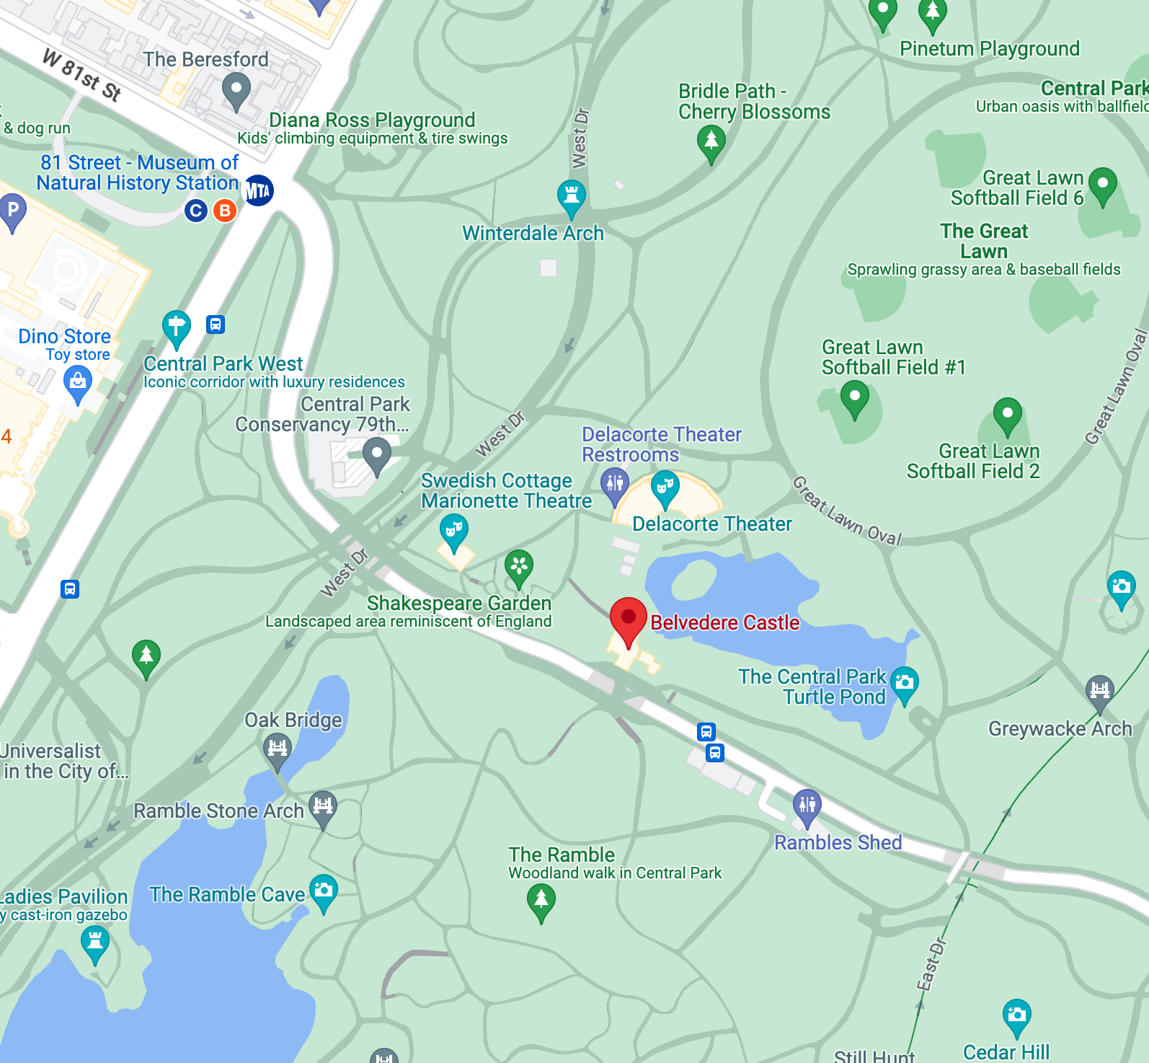
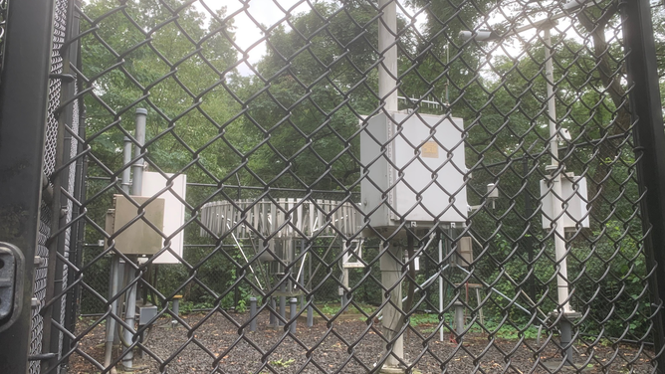
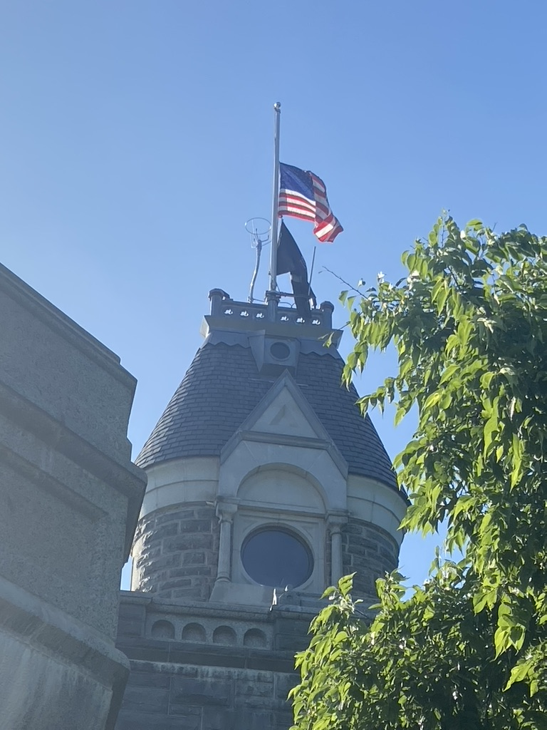
We’ll use a dataset of daily weather data from a station in Central Park
https://www.foxweather.com/weather-news/new-york-city-arguably-has-the-most-unique-weather-observations-in-america

Slide 20
We’ll use a dataset of daily weather data from a station in Central Park
Official National Weather Service site:
https://www.weather.gov/okx/centralparkhistorical
One of several official NWS observing stations in the NYC area:
https://www.weather.gov/wrh/Climate?wfo=okx

Slide 21
We’ll use a dataset of daily weather data from a station in Central Park
Hourly record of: wind, weather description, temperature, dew point temperature, relative humidity, wind chill or heat index, atmospheric pressure, and rainfall
Record spans from January 1, 1869 to today
We’ll use daily averages from 1869 through September 2023

Slide 22
We’ll use a dataset of daily weather data from a station in Central Park
For more, see this fun article: https://www.foxweather.com/weather-news/new-york-city-arguably-has-the-most-unique-weather-observations-in-america

Slide 23
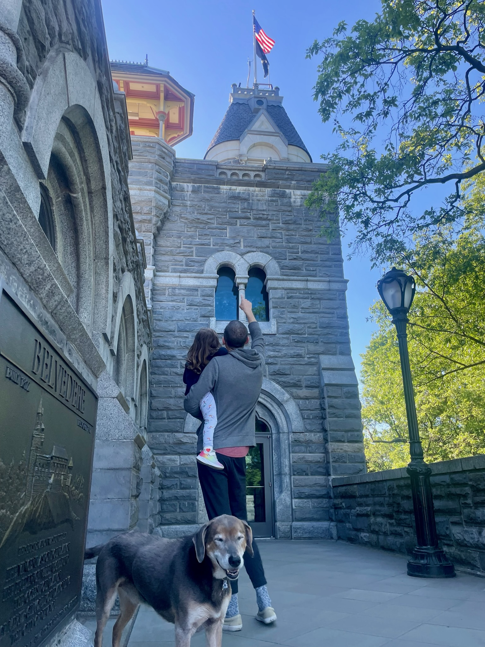
This is the most famous weather station in the world (to my 4-year-old daughter)

Slide 24

This is the most famous weather station in the world (to my 4-year-old daughter)
Jack and Annie get transported to NYC in 1938 and must free the unicorn from the tapestries at the Cloisters museum from their spell
Along the way….

Slide 25

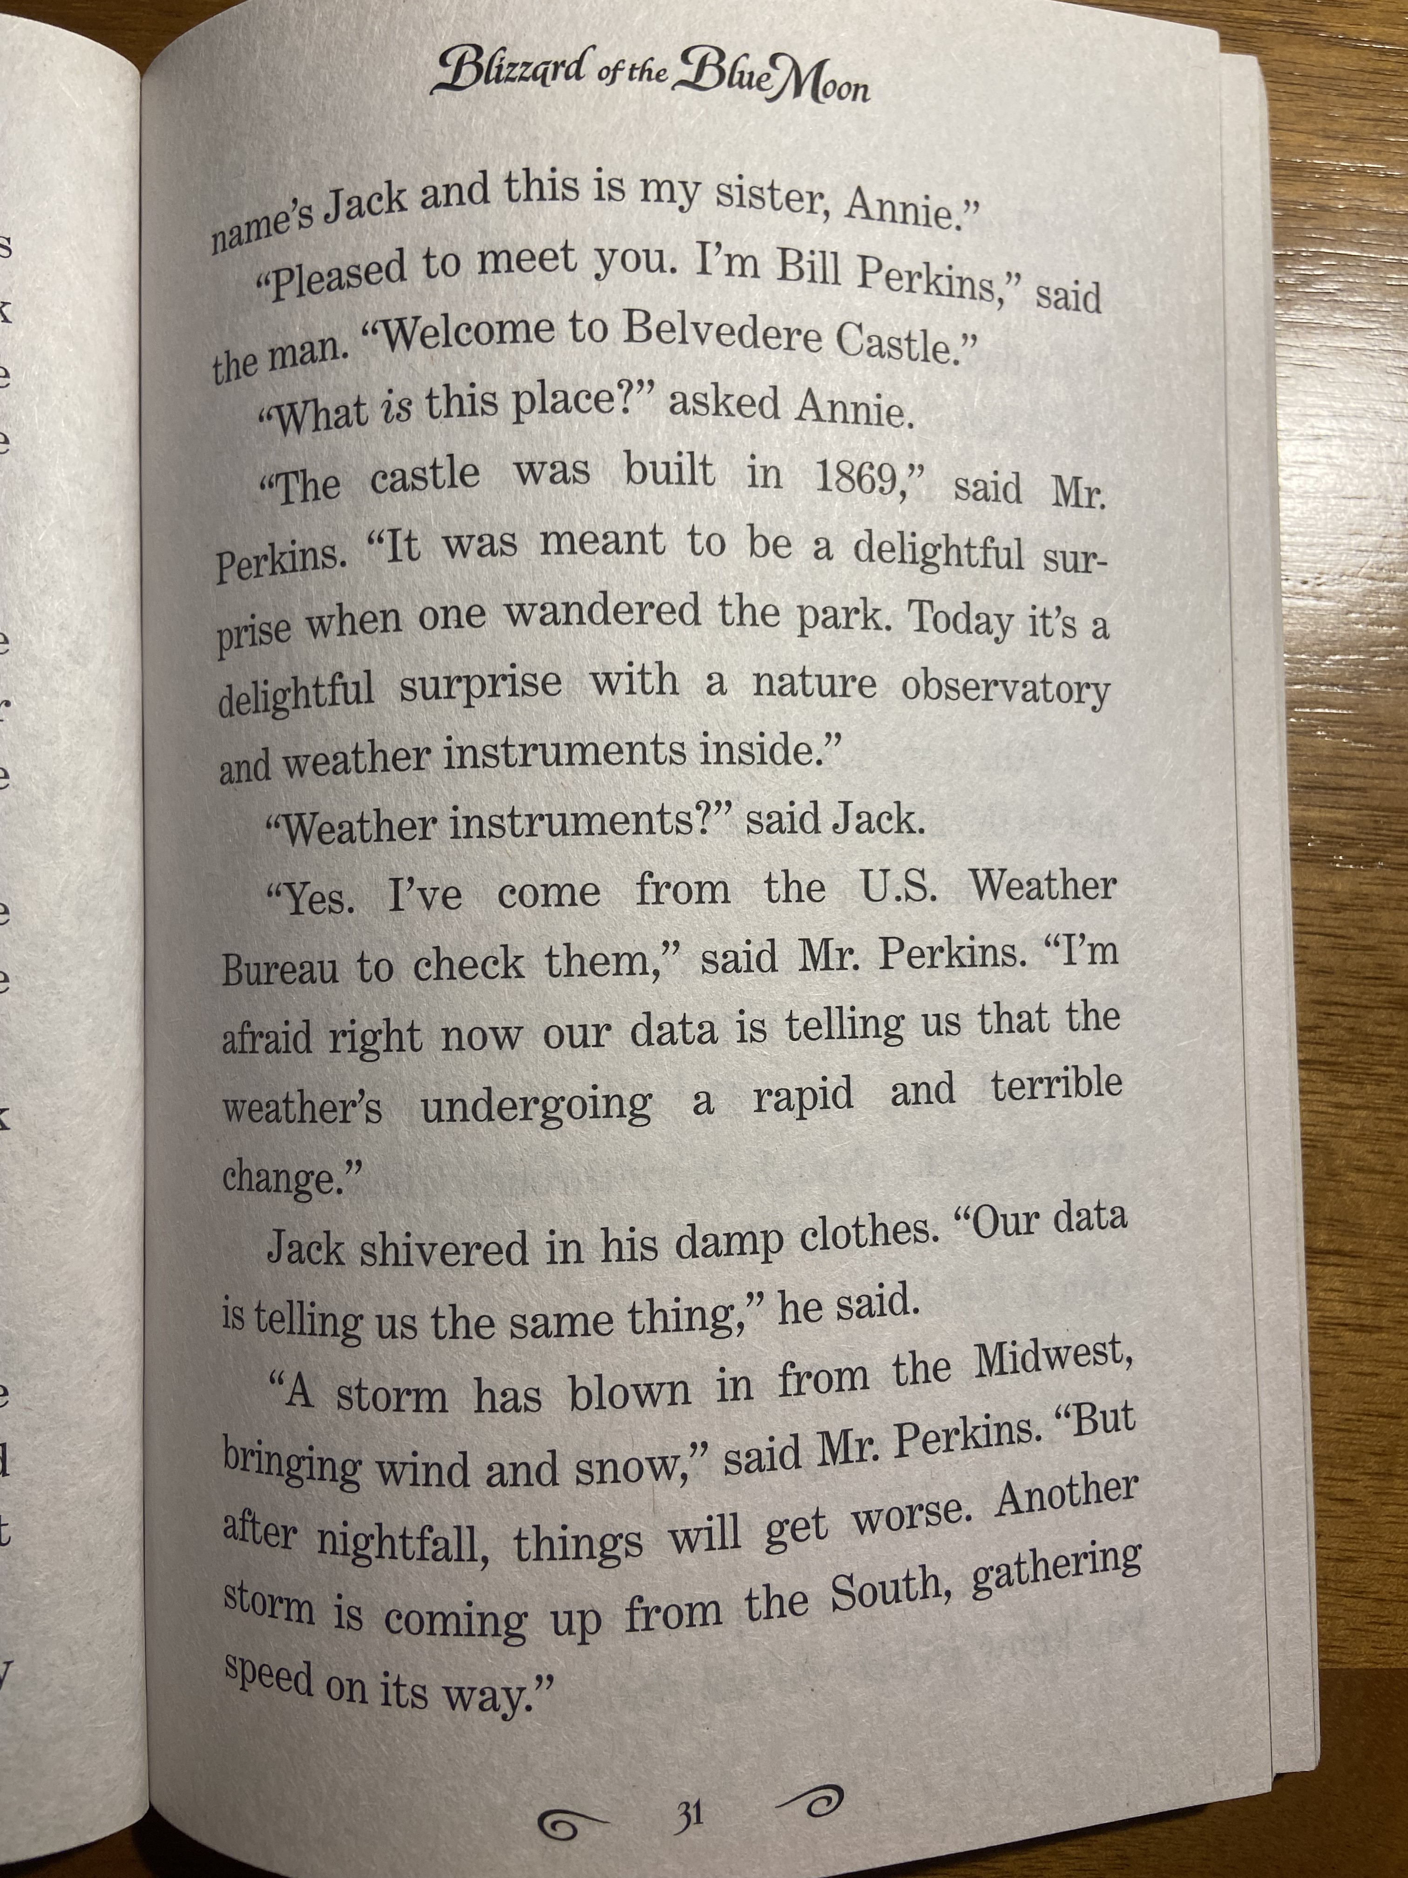

Slide 26
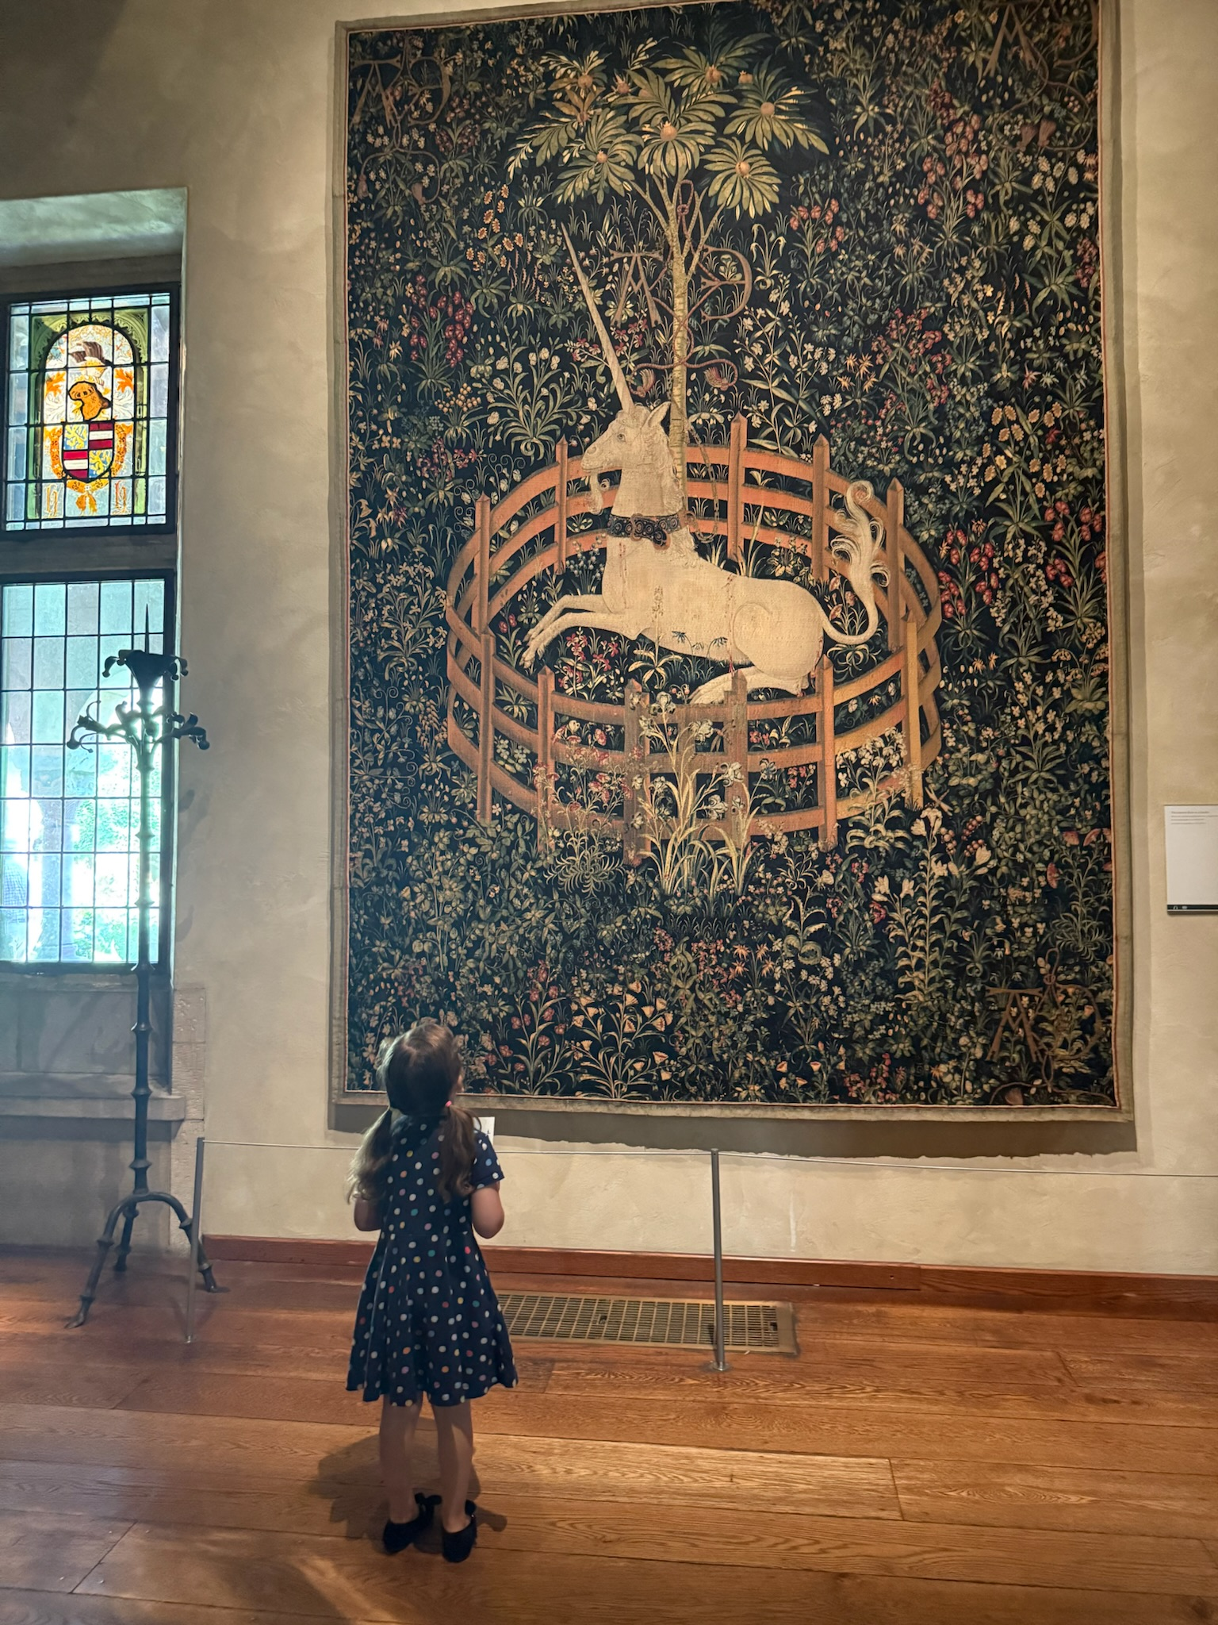

Slide 27
In 1920 the instruments were moved from their original location to the current one at Belvedere Castle
Why might that matter?

Slide 28
In 1920 the instruments were moved from their original location to the current one at Belvedere Castle
Conditions won’t be identical in the two locations, potentially creating a spurious jump (“discontinuity”) in the timeseries

Slide 29
Understanding how a dataset was produced should be “Step Zero” of any data analysis
That kind of “metadata” (data about data) isn’t just for fun
When you get a new dataset, it’s always tempting to dive right in, making plots, computing statistics, etc.
But how to interpret any plot or quantity you derive from a dataset depends on the nature of that dataset itself

Slide 30
Understanding how a dataset was produced should be “Step Zero” of any data analysis
“Don’t just do something…stand there!”
https://quoteinvestigator.com/2014/03/22/stand-there/
This is part of the numerate mindset we’re trying to build
Being able to crunching the numbers AND understand them, which requires knowing some context about the dataset

Slide 31
Understanding how a dataset was produced should be “Step Zero” of any data analysis
As such, in your final project, an important section of the written report will be describing your chosen dataset in this fashion
And identifying how that influences your interpretation of your subsequent analyses

Slide 32
Even then, how much do you trust the values, especially the extreme ones?
https://www.nytimes.com/1983/12/31/nyregion/city-s-rain-83-record-is-in-doubt.html
But still the data hosted online includes the 1983 rainfall values!
When you know data has a problem, but not precisely how to fix it, what do you do? No single right answer.
Summer undergrad interns in 2024 re-discovered this!

Slide 33
Another issue: “trace” snow and rainfall recordings
Switch to Jupyterlab for this…

Slide 34
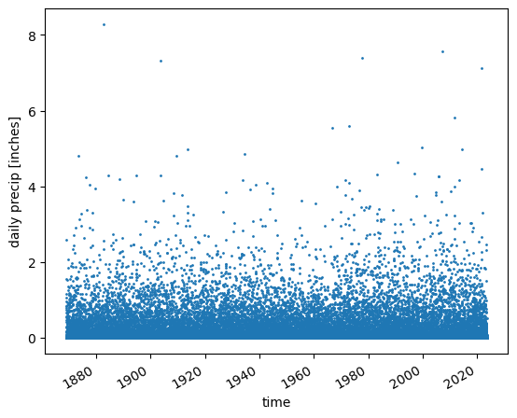
All that said, let’s (finally) go ahead and plot the Central Park rainfall timeseries
What things do you see that interest you or could potentially be important?
Think/pair/share

Slide 36
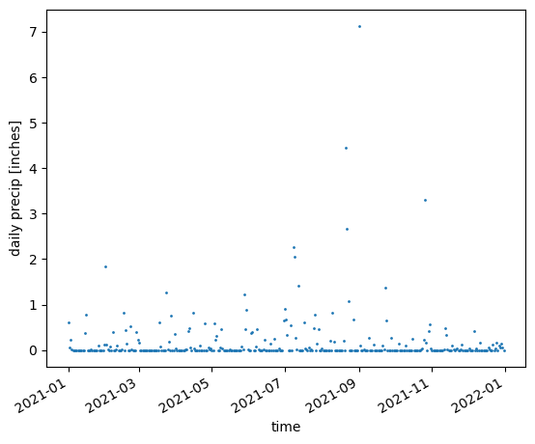

Slide 37
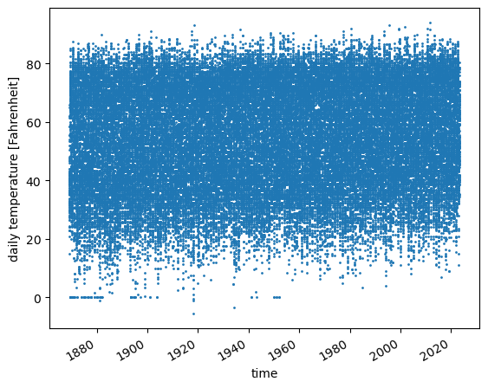
And now the same for the daily average temperature
What things do you see that interest you or could potentially be important?
Think/pair/share

Slide 38
A: They’re almost certainly artifacts…what might be the cause?
Do you think these circled values are “real”?

Slide 39
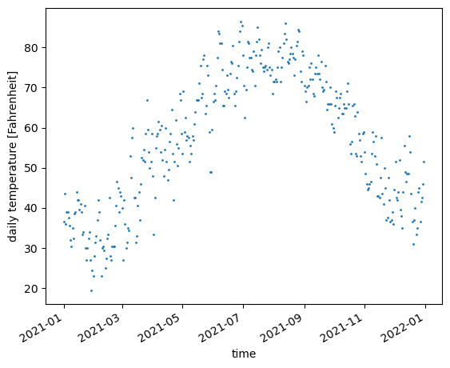

Slide 40
These plots definitely beat just printing out the values, but they’re still too much!
We ultimately need to boil them down to individual numbers (scalars) or small sets of numbers that human beings can digest

Slide 41
Today:
Numeracy in general ✅
The Central Park weather station dataset ✅
Real-world data inspection+cleaning example from published literature

Slide 42
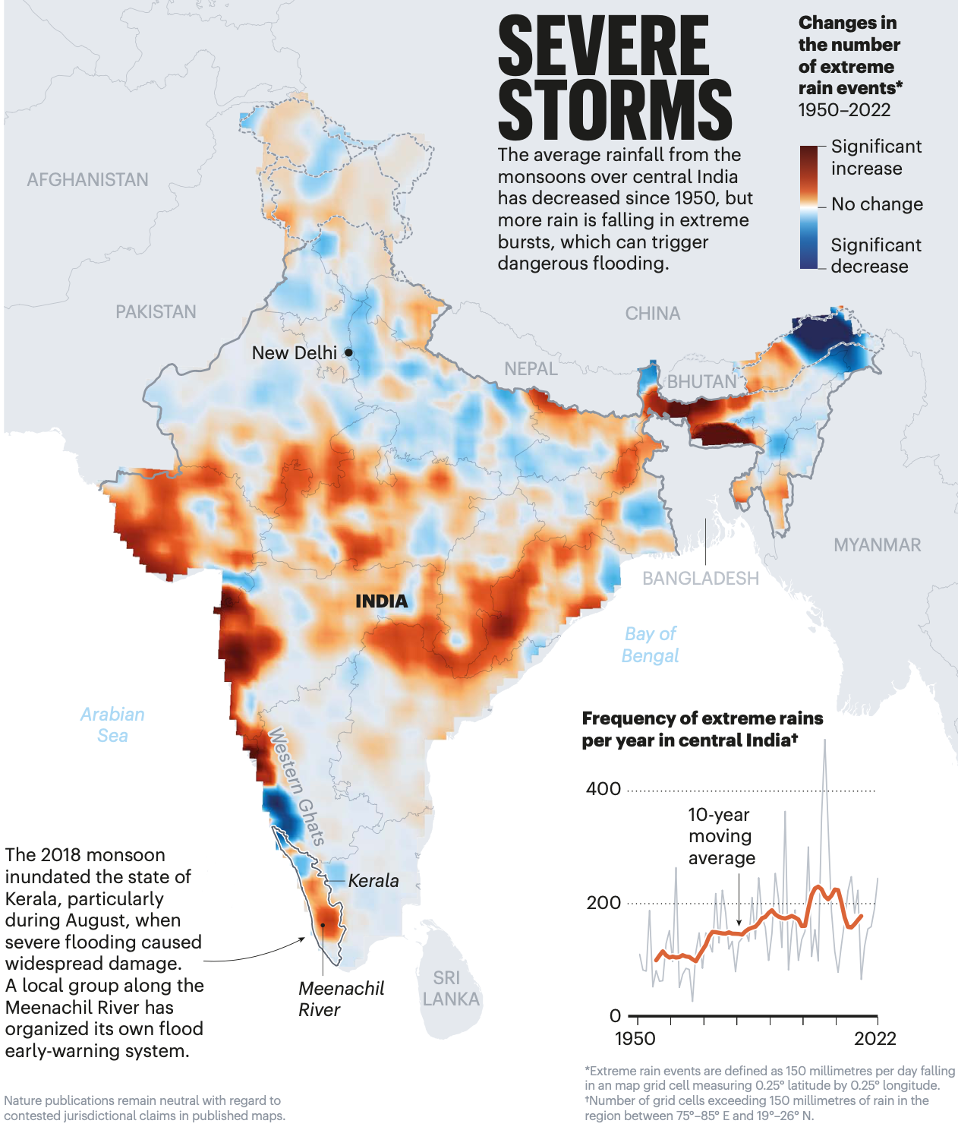
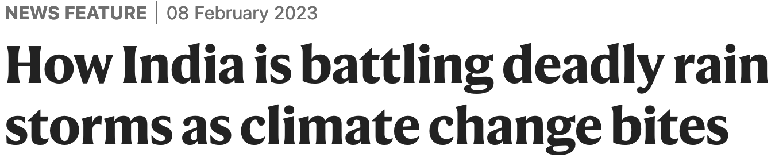
Daily rainfall dataset for India has been used to look at long term trends

Slide 43
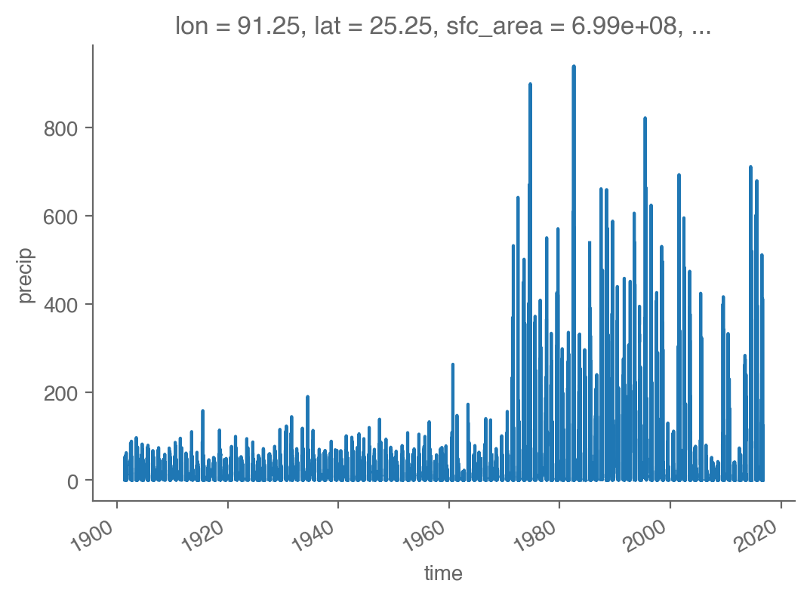
…but there are places where the data is clearly corrupted that people haven’t realized
This is not a real physical signal
…it is corrupted data!
Daily rainfall, 91.375E, 25.375N,
in IMD 0.25 dataset
For context, rest of domain, across all monsoonal India gridpoints:
Daily max = 803.9 mm/day

Slide 44
